Slide 1

Banking
Case Project
Prepared by : Himanshu Kumar

Slide 2



Bank Marketing Campaign Analysis
Term Deposit Subscription Study
Background
This project analyses a real-world banking dataset related to telephonic marketing campaigns conducted by a Portuguese bank.
The campaigns aimed to promote term deposit subscriptions among customers.
Objective of the
Project
Scope of Analysis
Data cleaning & preprocessing
Exploratory Data Analysis (EDA)
Distribution analysis of key variables
Correlation analysis with subscription outcome
Key insights and recommendations.
Understand customer demographics and financial attributes
Analyze campaign-related variables
Identify patterns influencing term deposit subscription
Provide data driven insights to improve targeted marketing.

Slide 3

Dataset Overview
Dataset Summary
Total Records: 45,211
Total Features: 17
Target Variable: y (Term Deposit Subscription)
Time Period: May 2008 – Nov 2010
Data Preparation Steps
Removed 5 duplicate rows
Dropped redundant columns (marital, day_month)
Encoded binary variables (yes/no → 1/0)
Imputed missing values using mode
In this dataset ‘Unknown’ is a defined category and must be kept, not treated as missing.

Slide 4
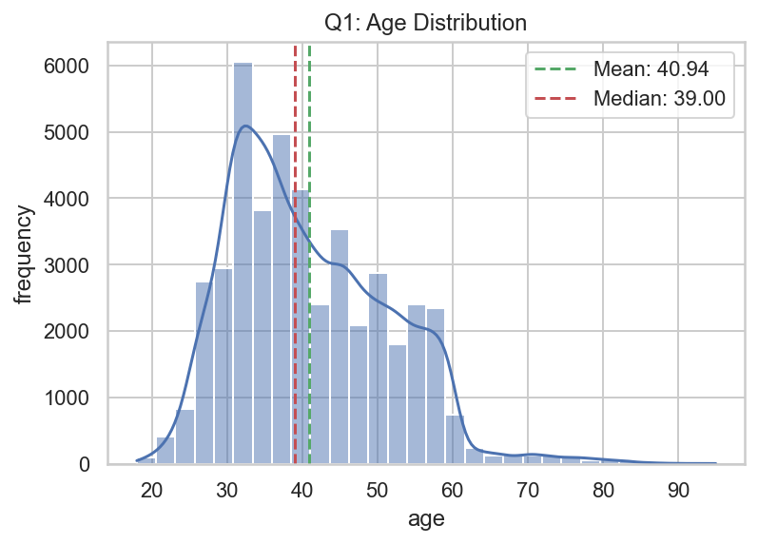
Customer Age Distribution
Key Insights:
Average age: 40.9 years
Majority between 30–50 years
Slight right skew
Few elderly outliers (up to 95 years)
Key Observation:
Middle-aged customers form the primary customer base.

Slide 5
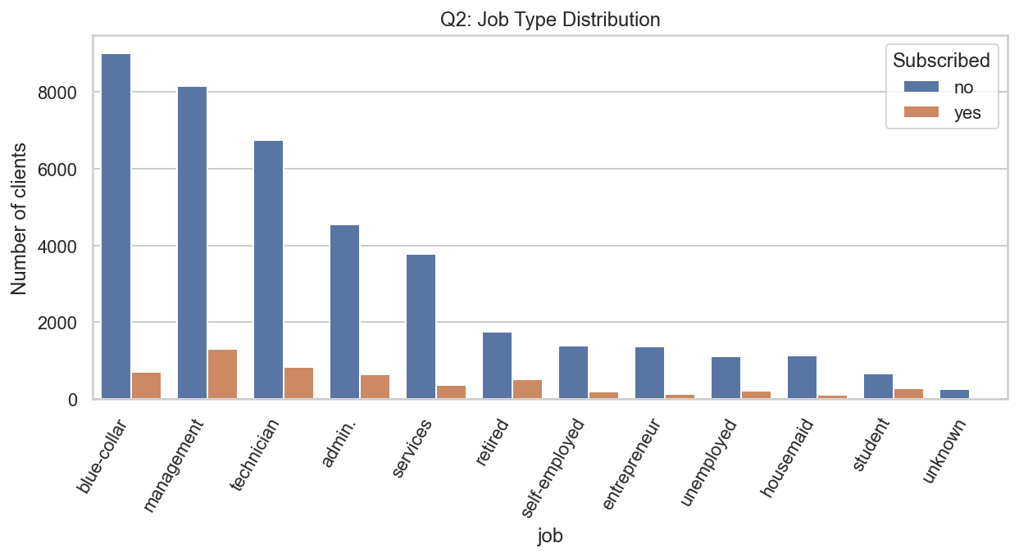
Job Type Distribution
Key Insights:
Management and technician segments show higher subscription counts.
Most common jobs:
Blue-collar
Management
Technician
Blue-collar segment has high volume but lower conversion ratio.
Key Observation:
Focus on professional and retired segments for higher campaign efficiency.

Slide 6
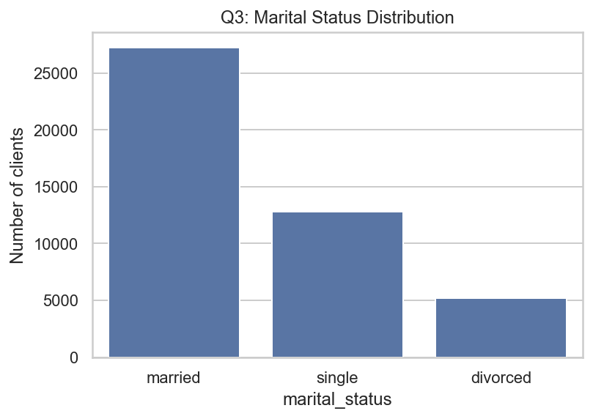
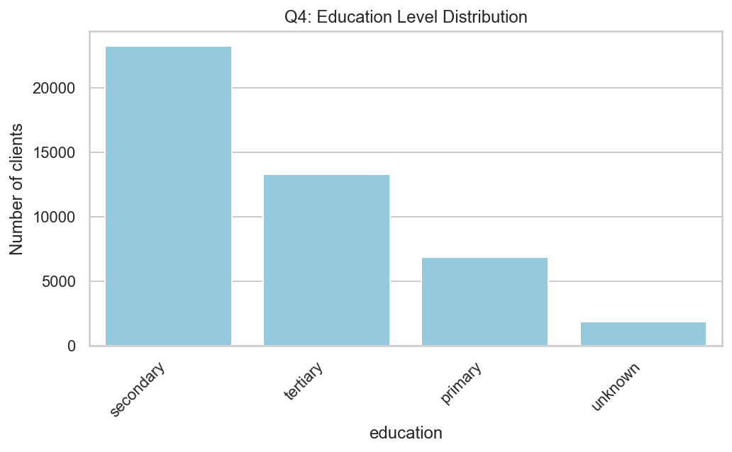
Marital Status & Education Profile
Marital Status:
60%+ married
Singles second largest group
Education:
Majority have secondary education
Tertiary education is significant
Key Observation:
Target audience mainly married & moderately educated.

Slide 7
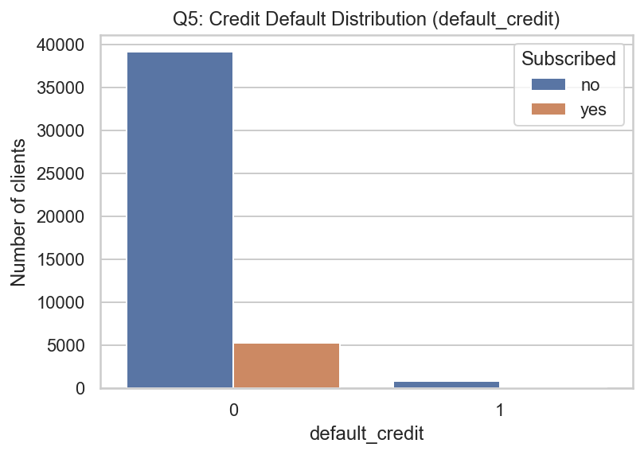
Credit Risk Profile
Key Insights:
Very small percentage (1.8%) in default.
Clients with credit default rarely subscribe.
Key Observation:
Low-risk customers are primary conversion drivers.

Slide 8
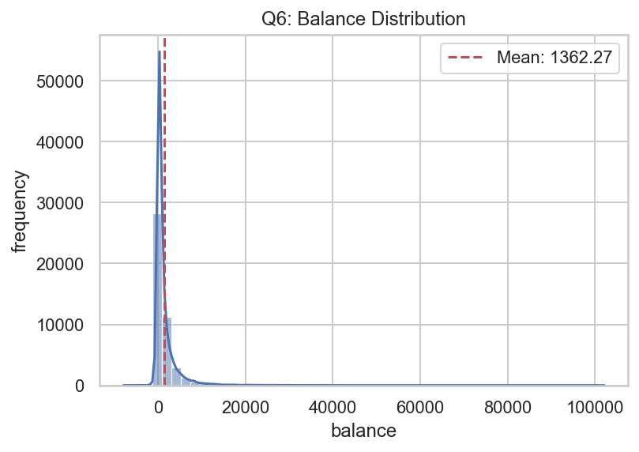
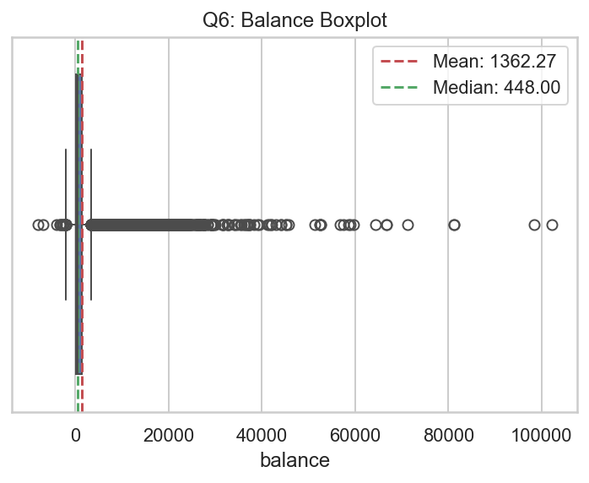
Financial Strength – Balance Distribution
Key Insights:
Mean balance: €1362
Median: €448
Highly right-skewed
4729 balance outliers
Key Observation:
Small group of high-balance customers skew average.

Slide 9
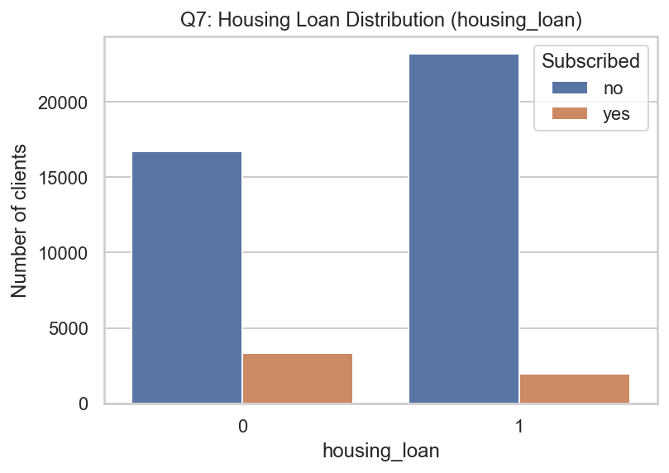
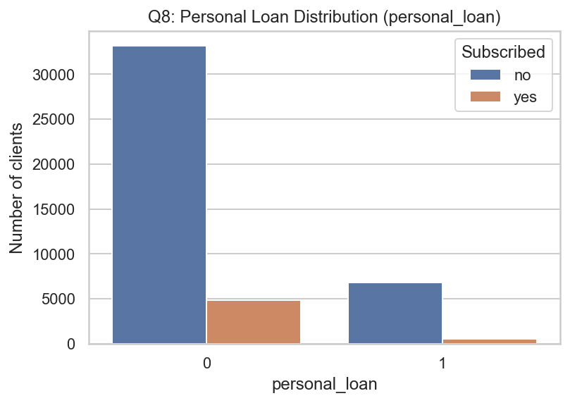
Loan Status Analysis
Key Insights:
Clients without housing loans show slightly higher subscription rates.
Housing loan holders show lower probability of subscribing.
Key Observation:
Existing financial commitments may reduce investment willingness.
Key Insights:
Personal loan holders show lower subscription rate.
Non-loan customers convert better.
Key Observation:
Clients already managing debt are less likely to invest.

Slide 10
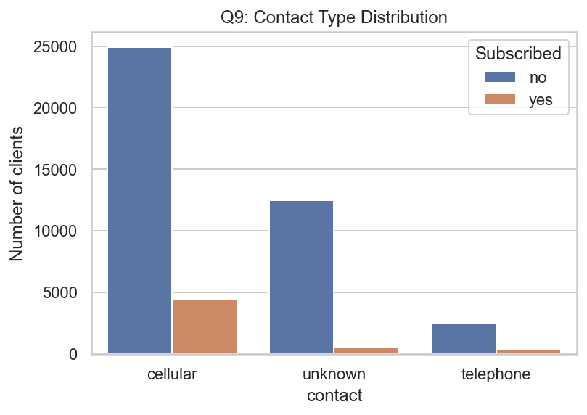
Contact Method Effectiveness
Key Insights:
Cellular contact yields highest conversions.
Telephone channel shows weakest performance.
Unknown category has poor conversion.
Key Observation:
Mobile-based outreach is most effective marketing channel.

Slide 11
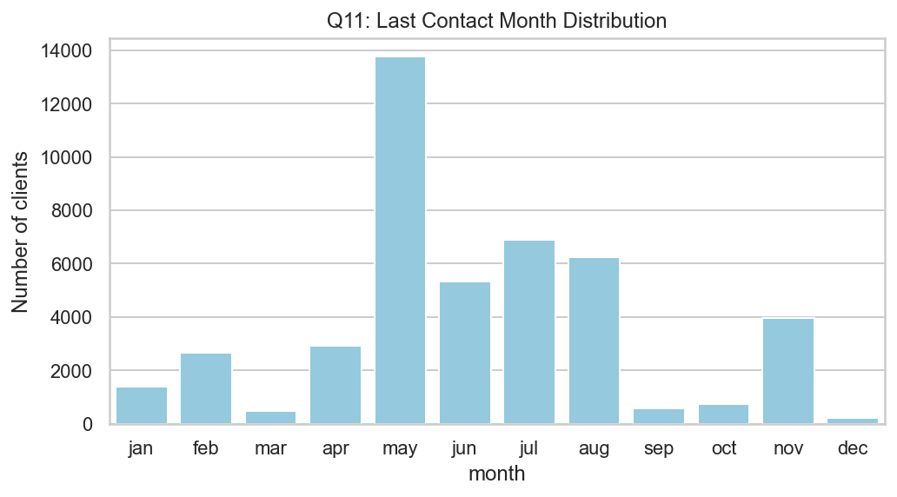
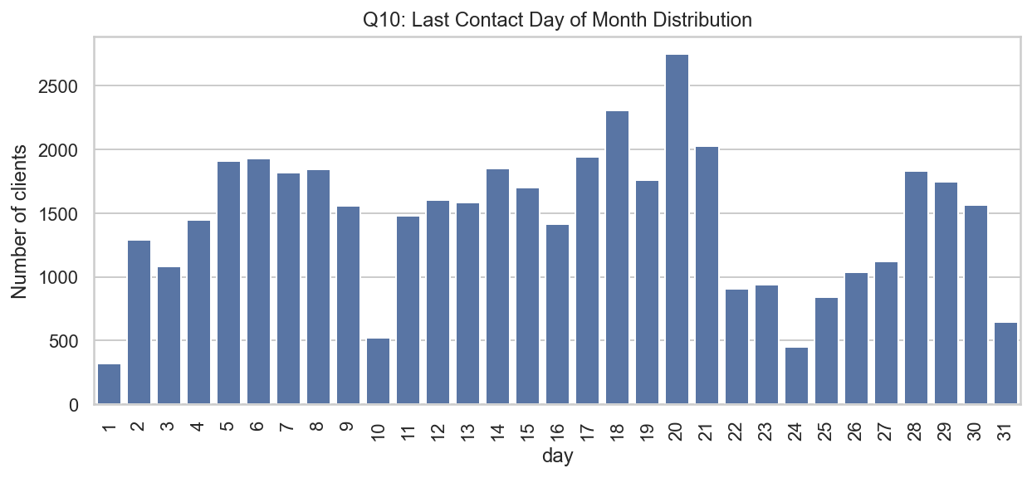
Campaign Timing Analysis
Observations:
Peak campaign month: May
Strong activity in June, July, August
Day 20 most frequent contact day
Key Insight:
Campaign concentrated mid-year.

Slide 12
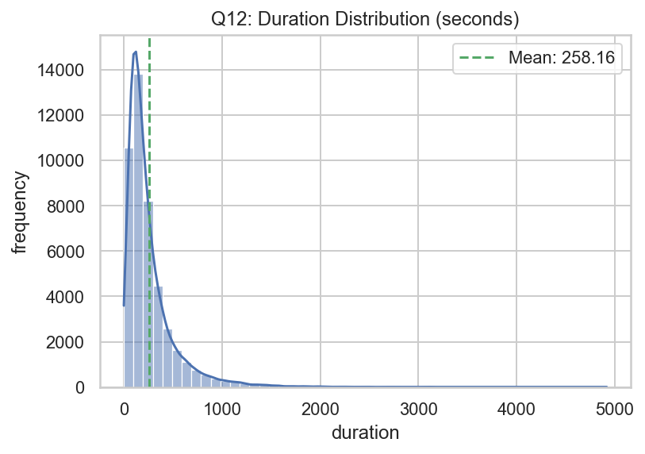
Call Duration Analysis
Key Insights:
Average call duration: 258 seconds
Highly skewed distribution
Long calls associated with higher success
Critical Insight:
Duration has strongest positive correlation (0.39) with subscription.

Slide 13
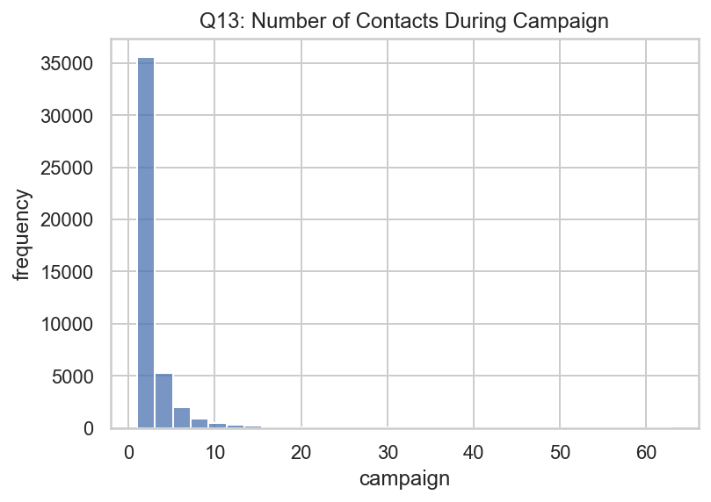
Campaign Intensity
Observations:
Most clients contacted 1–3 times
More contacts → lower subscription rate
Correlation:
Campaign correlation with y = -0.07
Key Insight:
Excessive calls reduce effectiveness.

Slide 14
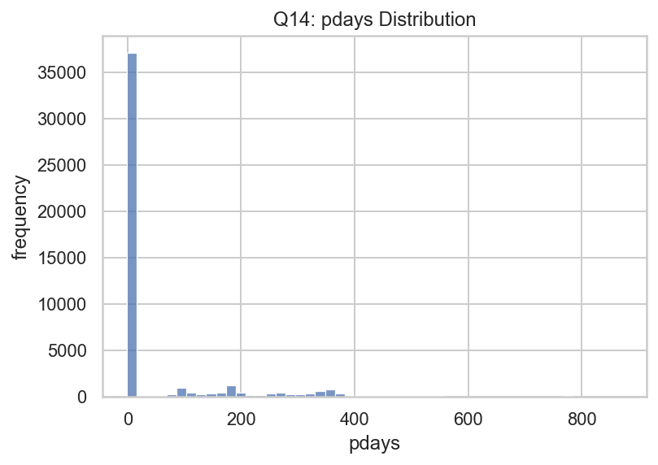
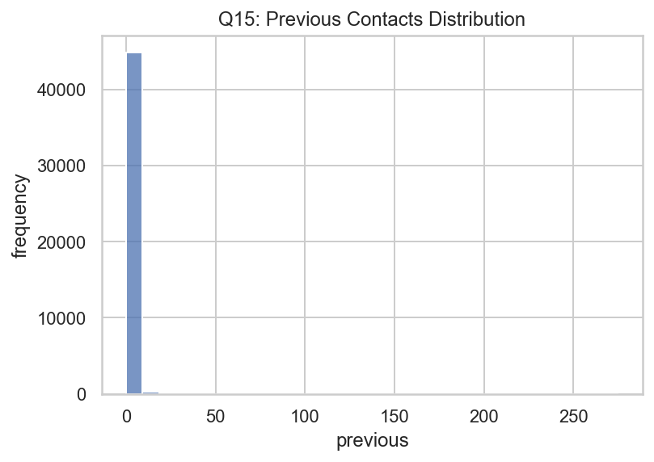
Previous Campaign History
Observations:
36,954 clients never contacted before
Very few had previous interactions
Key Insight:
Large untapped customer base.
The distribution of pdays is highly skewed because many clients were never previously contacted (pdays = -1)
Similarly, the previous variable is heavily concentrated at 0, indicating most clients had no prior campaign interactions.

Slide 15
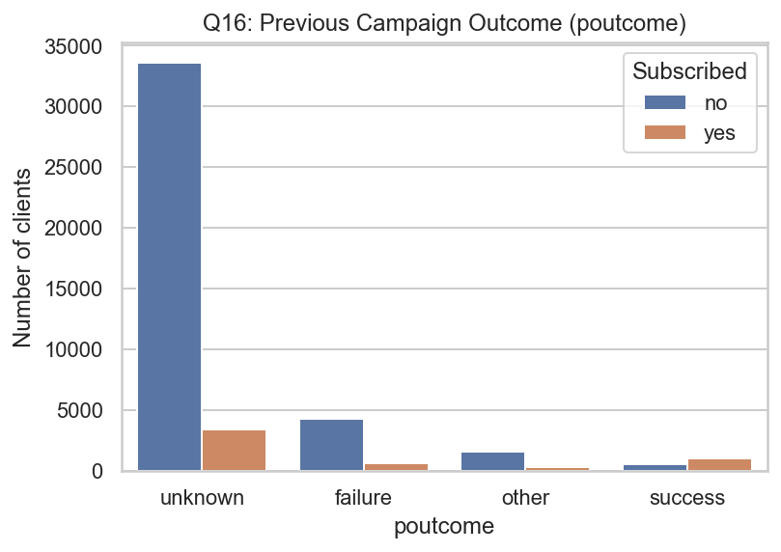
Previous Campaign Outcome Impact
Key Insights:
Clients with previous success show significantly higher subscription.
Unknown outcome dominates but has low conversion.
Previous failure reduces likelihood.
Key Observation:
Past successful engagement is a strong predictor of future success.

Slide 16
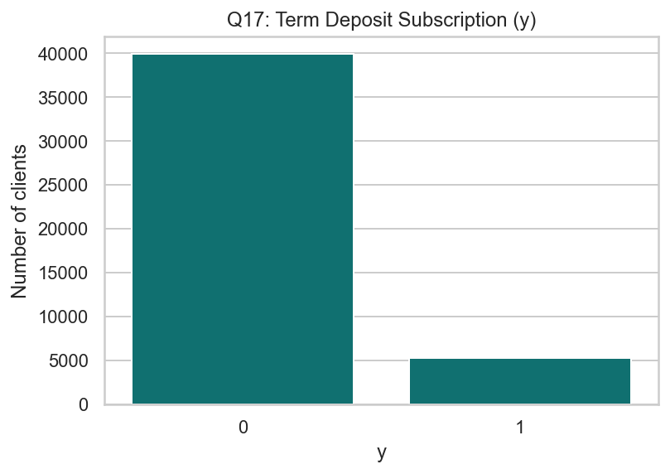
Subscription Distribution
Key Numbers:
Subscribed: 5,289
Not Subscribed: 39,922
Subscription rate: 11.7%
Key Observation:
Highly imbalanced outcome. Campaign conversion is relatively low.

Slide 17
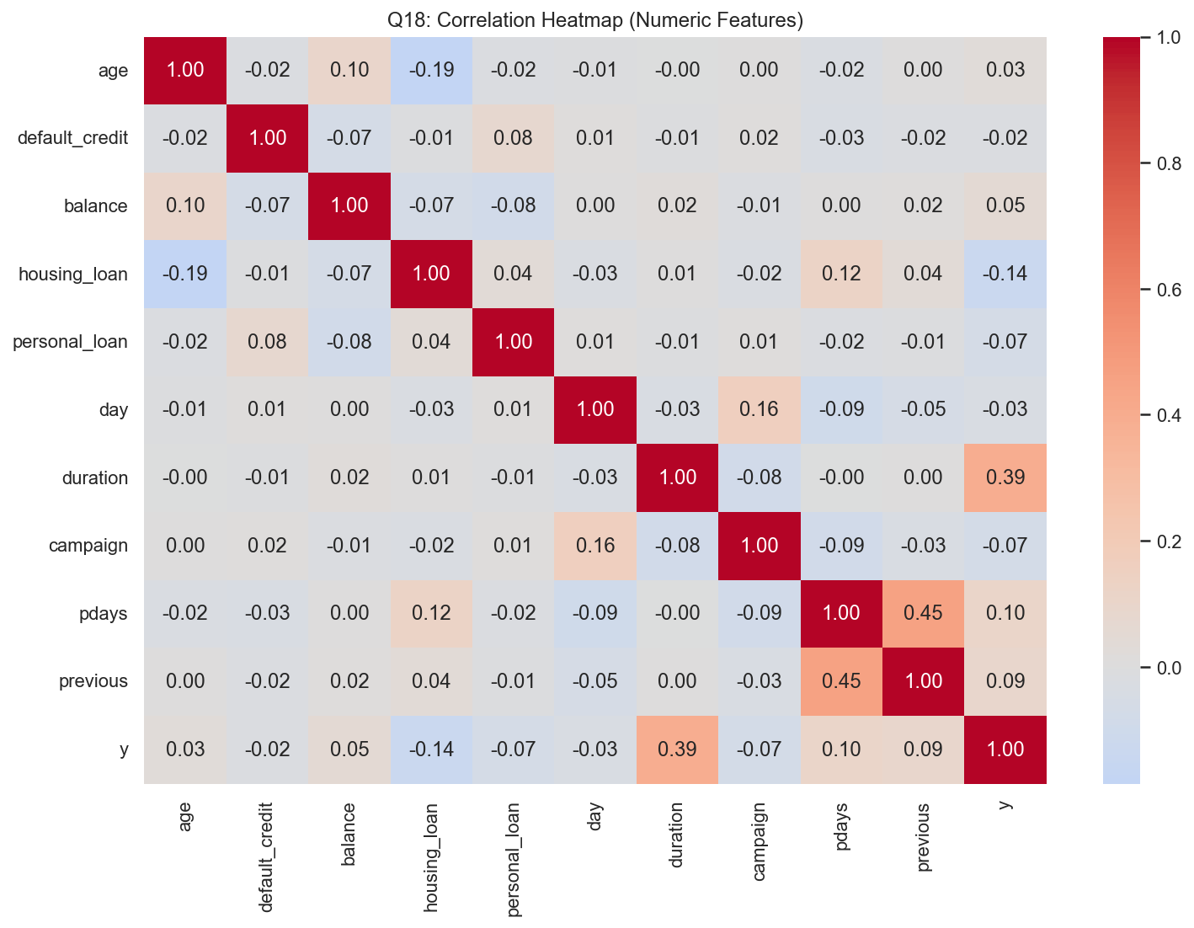
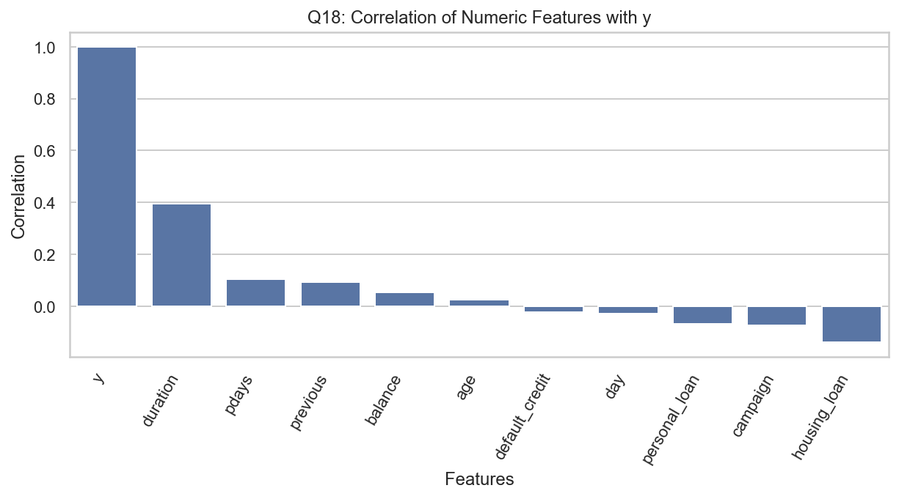
Correlation Analysis
Strongest Positive Drivers:
Duration (0.39)
pdays (0.10)
previous (0.09)
Negative Drivers:
Housing loan (-0.14)
Campaign (-0.07)
Personal loan (-0.07)
Key Insight:
Call duration is the strongest driver of subscription probability.

Slide 18

Strategic Recommendation
Focus on Call Quality, Not Quantity
Longer, meaningful conversations increase conversion.
Prioritize Customers with Past Success
Higher likelihood of subscription.
Optimize Campaign Frequency
Avoid excessive repeated calls.
Target Mid-aged, Working Professionals
Core customer segment identified.

Slide 19

Thank You

